Slide 1
Mobile Backhaul Mindmaps

Slide 2
1.2
Mobile Backhaul
unites a mobile network with transport/packet networks

Slide 3
2.1 Backhaul Network, Tiers and Cost

Slide 4
2.1.1 Backhaul Network Tiers
Backhaul Network Tiers
Access
tier
Aggregation
tier
Backbone
tier

Slide 5
2.2
Legacy Backhaul Networks
Backhaul Basic Technologies
TDM transport technologies
some ATM equipment
Backhaul Topology
GSM & WCDMA
WCDMA
2 & 3G
Tree Topology
Chain Topology

Slide 6
2.3 Drivers for the MBH Network Change
Drivers for the MBH Network Change
Higher and More Bursty Transport Load
More Cells Sites
Revenue Per Bit Decreasing
Lower Operational Costs
Developments in General Transport
Mobile Service Developments and Traffic Growth (2.3.1)
Traffic Forecasts Needed for Proper MBH Design
total mobile traffic forecasts (essential)
Traffic Peak Rates
Average Service Bit Rate
Traffic Distribution Into Classes

Slide 7
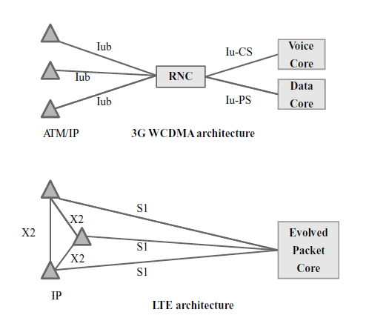
2.3.2
Mobile Network Developments
More Native Packet Traffic
Flatter Mobile Network Architecture
Base Stations May be Connected to Several Core Sites
No more controllers between the base stations and core elements
Direct Links Between New Base Stations
More Urban (Hot Spot) Cell Sites
Connecting Temporary Cells
Native Packet=The signal was always a packet

Slide 8
2.3.3
Backhaul Cost-Efficiency Improvements
Lower Costs for Higher Backhaul Capacities
Packet-based transport equipment usually has significantly lower costs
Another method is to try to increase sharing of physical links
Better Ability to Handle Highly Bursty Traffic
Optimized Backhaul Dimensioning

Slide 9
2.3.4
Lower Operational Costs
Network Simplification
targetMBH network has a simple clear topology
Similar Technologies
New Equipment with Better Performance and Management
Network Automation
Use of similar technologies and similar kind of equipment in the MBH network clearly
contributes favorably to network simplification
Newer generation equipment generally has better power-efficiency
For example, creation of new logical connections within
the MBH network, or modification of existing ones, can be carried out with little manual
work.

Slide 10
2.3.5
Developments in General Transport
The costs of packet-based transport solutions have become much lower
than those of similar capacities with TDM (or ATM) technologies
packet-based connections will be much more widely available and will have lower
price tags

Slide 11
2.4
Packet Based Backhaul Networks
Physical Network and Topology
structure and topology will often look quite similar to that of the earlier MBH networks
Logical Network and Protocol Layers
even if a MBH network is based
on packet technology, it is a MBH internal solution and separate from the packet technology
used for the end-user traffic

Slide 12
2.5
Making Transition to Packet Technology Networks
Transition Strategies for Packet-Based Backhaul
A Target MBH Network
Serving Existing and New Mobile Systems
Implementing Transition and Network Evolution
Details on next graph
Different Type of Areas
Overlay or Replacement
Leased Lines and Out-Sourced Transport Services
major MBH expansions in business districts, city centres
smaller traffic increase =
new technology base stations are coming later.
Overlay= easier to do but more complex to maintain
Replacement= harder to implement but simpler architectury
Combined MBH Solution= Leased Line + own MBH Nw

Slide 13
2.5 devam
Implementing Transition and Network Evolution
Planning the Changes
Addition of New Equipment and Links
Parallel Working of Old and New
Simplifying the Network
Accurate Planning
Acc. timing
Addition of new eq.
Creating connections over the new links
Addition of new equipment needs careful consideration on small sites, especially on small
base station sites, and on leased sites.
the MBH networks often include different types of
connections, also between the same sites, and network operations may for a period need more
attention.
This step usually means significant
complexity reduction in network management and in network operations, and thus helps to
reduce the MBH operational expenses, as discussed earlier.

Slide 14
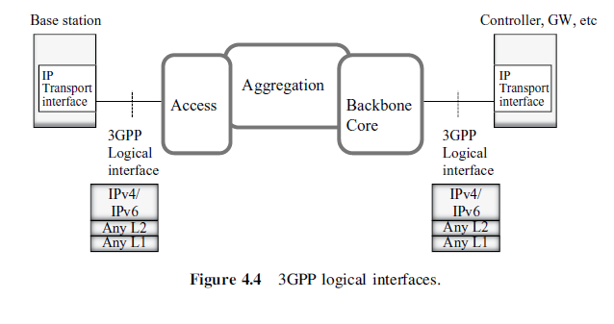
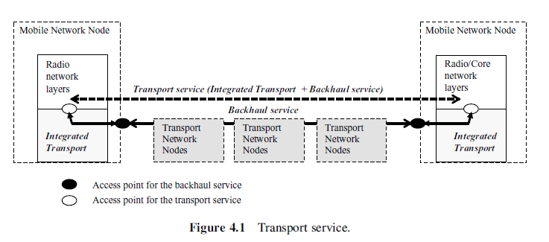
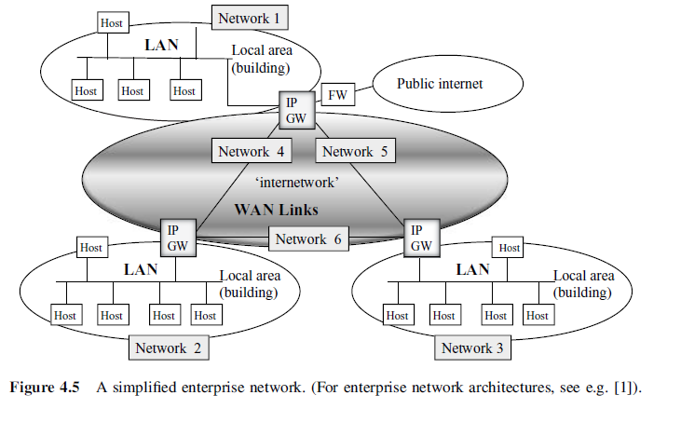
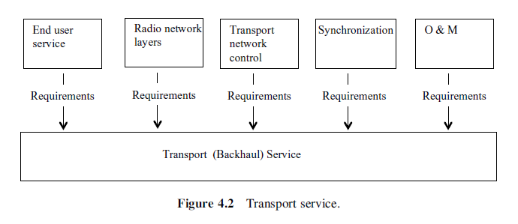
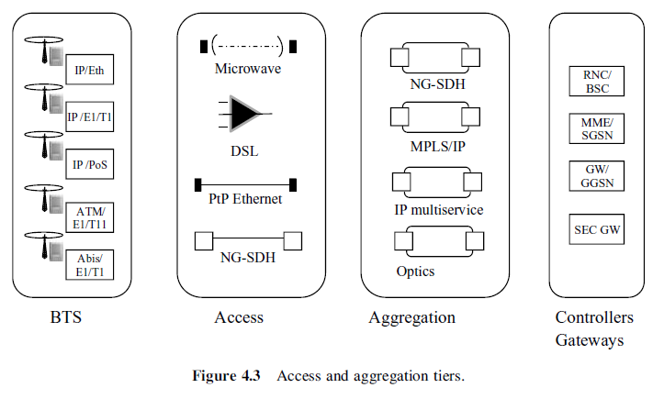
4
Mobile Backhaul Application
Backhaul Service
Standardization
IEEE
Transport service to the radio network
a backhaul service
an integrated transport
Access, Aggregation and Core
Aggregation means merging
3GPP Guidance for the Backhaul
3GPP has little guidance on how to build the backhaul
Networking and Backhaul
For cost optimization, it is crucial to have low cost ports at the hosts, and a low costtechnology for any LAN.
IETF
The Internet Engineering Task Force (IETF)
ISO
International Organization for Standardization
IEEE (Institute of Electrical and Electronics Engineers)
ITU, International Telecommunications Union
ITU-T
MEF
Metro Ethernet Forum
IP/MPLS Forum
Base Station—3GPP Logical Interface—Access/Aggregattion/Backbone Core---3GPP Interface-Controller

Slide 15
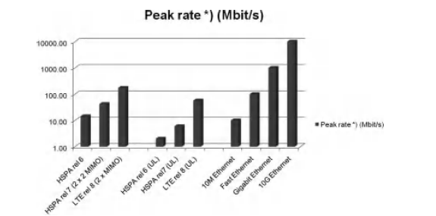
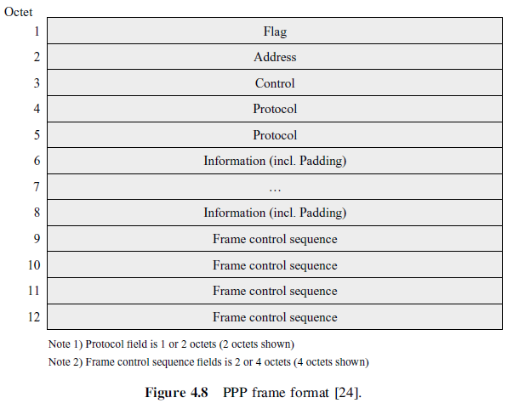
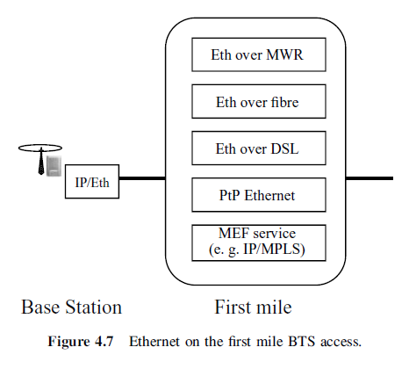
4.3
Physical Interfaces
High Data Rates
key benefits of an Ethernet port
Ethernet Ports
IEEE standard
High capacity
Low cost
1Gbit/s = Gigabit Ethernet
data rates for 10 Mbit/s (10 BaseT),
100 Mbit/s (FastEthernet)
A single elec. Ethernet Port can support speeds of 100/1000 Mbit/s
Physical Connection
Twisted Pair cable
Optical Fiber
not suited for long-distance transmission
TDM Interfaces
E1
T1
JT1
SDH/Sonet
Synchronous Digital Hierarchy
Synchronous Optical Networking

Slide 16
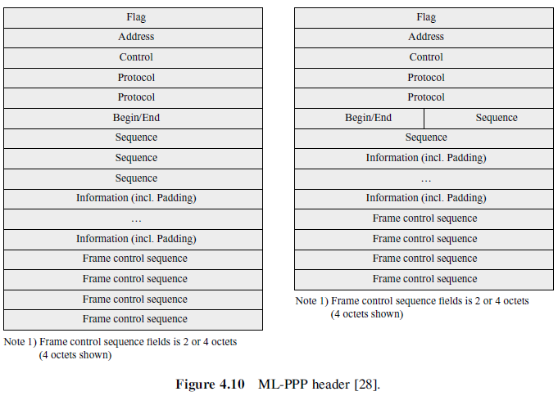
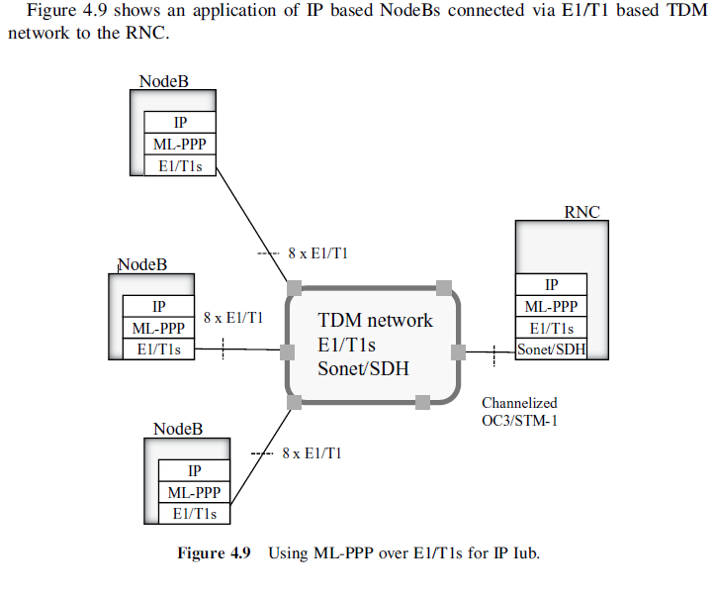
4.4
PPP & ML-PPP
Point-to-Point Protocol
multi-link point-to-point
In computer networking, Point-to-Point Protocol (PPP) is a data link layer (layer 2) communication protocol between two routers directly without any host or any other networking in between
In order to increase the data rate capability with the IP over PPP over E1/T1/JT1s, it is possible to combine a number of these lines to create a higher capacity service
PPP over Sonet/SDH
IP over PPP (or ML-PPP) over E1/T1s, IP can be mapped into PPP and further to the Sonet/SDH containers, as Sonet/SDH essentially is a point-to-point full-duplex link Often the solution is called Packet over Sonet.

Slide 17
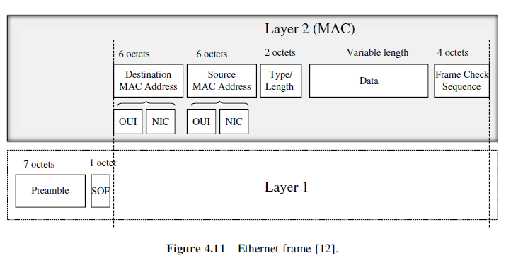
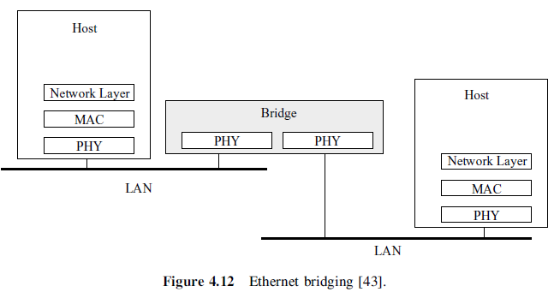
4.5
Ethernet and Carrier Ethernet
Carrier Ethernet
Services
Scalability
Ethernet and Ethernet Bridging
The main operations of Ethernet bridging are
Reliability
Quality of Service
Service Management
forwarding of the L2 frames, based on filtering rules (e.g. MAC address table),
creating the filtering rules (by MAC address learning and/or other methods
An Ethernet bridge works on the MAC layer, and is transparent to the network level
protocol.
Ethernet Link Aggregation
supports combining multiple Ethernet links into a group, which is seen by the Ethernet MAC client as a single link
VLANs

Slide 18
4.6
IP & Transport Layer Protocols
IP
The Internet Protocol
IP address Assignment DHCP
DHCP
Forwarding
IP Routing
Routing Protocols
Learns Rules to destination networks from other routers
Differentiated Services
QoS( quality of service)
Address Resolution Protocol
Ethernet L2 MAC address of the next hop router is needed before an IP packet can be sent over the Ethernet interface. Before a BTS can send any IP packet over its Ethernet interface, it needs to know theMAC address of the next hop router. The protocol to query theMAC address of a specific IP address is Address Resolution Protocol (ARP), defined in RFC 826 [94].
ICMP
Internet Control Message Protocol
UDP
UDP (User Datagram Protocol)
RTP
Real-time Transport Protocol
TCP
In the mobile backhaul protocols stacks, TCP is not included
IPv6
IPv4-only device is not capable of routing IPv6 packets

Slide 19
4.7
Multiprotocol Label Switching (MPLS)
MPLS Architecture
LBGPabel Distribution Protocol
With MPLS, the meaning of labels has to be agreed between Label Switch Routers (LSRs).
packets are classified into Forwarding Equivalence Classes (FECs) and are assigned an MPLS label accordingly
MPLS routers are called Label Switch Routers (LSRs).
LDP messages fall into four categories:
peer discovery;
session management;
label distribution (advertisement);
* notification messages (errors, advisory information).
BGP
MPLS Ping
MPLS L3 VPN and MP-BGP

Slide 20
6 Synchronization
Synchronization has been always one of the key issues in cellular networks and a lot of effort
has been put to this single topic. Even conferences are arranged yearly in the area of
synchronization in telecom. In this context, the word telecom refers ultimately to cellular
networks in almost all cases.

Slide 21
6.1
Cellular Networks Synchronization Requirements
Frequency Accuracy
In cellular networks the frequency accuracy requirement is clearly higher than needed for
eliminating interference between neighbouring radio bands
Time Accuracy
CDMA
TDD Systems
CDMA variants are FDD (Frequency Division Duplex) systems that, nevertheless, require
time synchronization
TDD (Time Division Duplex) systems such as Mobile WiMAX, WCDMA TDD, and LTE
TDD require time synchronization
Single-frequency Network
Single-frequency network (SFN) technique is used in downstream direction for example in
Multimedia Broadcast Multicast System (MBMS). More than one base station transmits the
same signal.
Enhanced 911 Phase II OTDOA Location Determination

Slide 22
6.2
Frequency Synchronization in TDM Networks
Synchronization Architecture in TDM Networks
PDH
Plesiochronous Digital Hierarchy
SDH/SONET
Synchronous Digital Hierarchy/Synchronous Optical Network
ATM
Asynchronous Transfer Mode
OTN
Optical Transport Network

Slide 23
6.3
Frequency Synchronization in Packet Networks
ACR (Adaptive Clock Recovery)
NTP (Network time protocol)
PTP (Precision Time Protocol)
ITU PTP Telecom Profile for Frequency Synchronization
Synchronous Ethernet
Over Optical Transport Network, OTN
One-way Synchronous Ethernet Links
Chaining Different Synchronization Technologies
TICTOC

Slide 24
6.4
Synchronization Metrics for TDM and Synchronous Ethernet
Stability Metric MTIE
Simply, the accumulated phase error over a time period is the average frequency error
times the length of the time period
Frequency error is calculated as the difference between the
measured and reference frequency, divided by the reference frequency
Relationship between TDM Wander Specification and Base Station
Clock Accuracy
The wander masks can be compared with the 16-ppb frequency stability requirement of
cellular base stations
TDEV
TDEV (Time Deviation) is another metric used in telecom. It describes time stability of a clock
as a function of averaging time

Slide 25
6.5
Packet Synchronization Fundamentals and Metrics
The Principles of Packet Timing for Frequency Synchronization

